Slide 1
 | Make Font Bigger | Make Font Smaller | Change colour of Font | Change Font Type | Change Background Colour | Examine ALT tags on Image | Simplify Text | Make Images Bigger | Explain Table
Dyslexia | X |  | X | X | X |  | X | X | X
Dyscalculia | X |  | X | X | X
Dyspraxia | X
Dysgraphia
Autism |  |  | X |  | X |  | X | X
ADHD | X |  | X |  | X |  | X
Visual Impairment | X |  | X | X | X | X | X | X | X

Slide 2
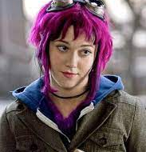
Mary Elizabeth Flowers
Age: 18
Degree: Computer Science
Tech Ability: High
Hobbies: Music, Steampunk, Skateboarding
Disability: Dyslexia
Description: Girl, aged 18, who has dyslexia likes listening to her Ipod and also likes skateboarding who is doing a degree in Masters in Accessibility

Slide 3
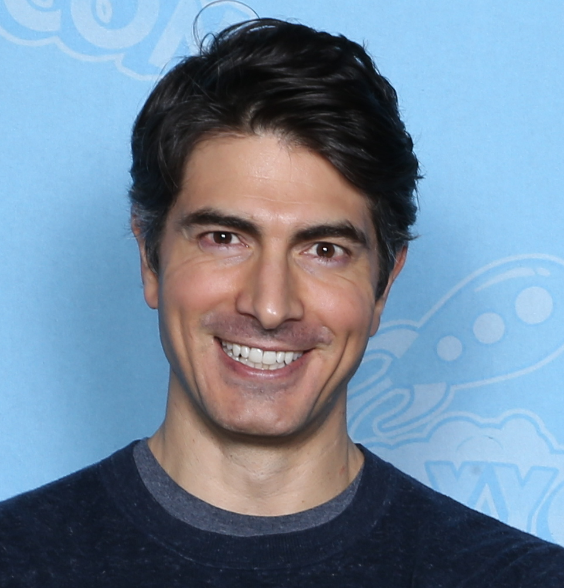
Todd Routh
Age: 42
Degree: Law
Tech Ability: Medium
Hobbies: Basketball, Hiking and Reading
Disability: Macular Degeneration
Description: He is looking to go back to college to learn how to read and write as he is going to lose his vision.

